Slide 1
LEC -2 INTRODUCTION
(Introduction to internet, browser, web server, URL, domain name, IP address, packets)

Slide 2
What is Internet ?
The Internet is called a globally connected network system that facilitates communication and data services through a vast collection of private, public, business, academic, and government networks.
It is a collection of millions of computers, webpages, websites, and servers.
Using the internet we can send emails, photos, videos, messages to our loved ones.

Slide 3
What is a Web Browser? Examples of Web Browser?
A web browser is a type of software application that is used for accessing the world wide web(www) or as known by everyone on the Internet.
It act as a interface between us and the information available on the web.
The web browser can be called a client program as it requests the webserver for the information demanded by the user. Some of the common browsers are Google, Mozilla Firefox, Safari, internet explorer, Netscape Navigator, etc.

Slide 4
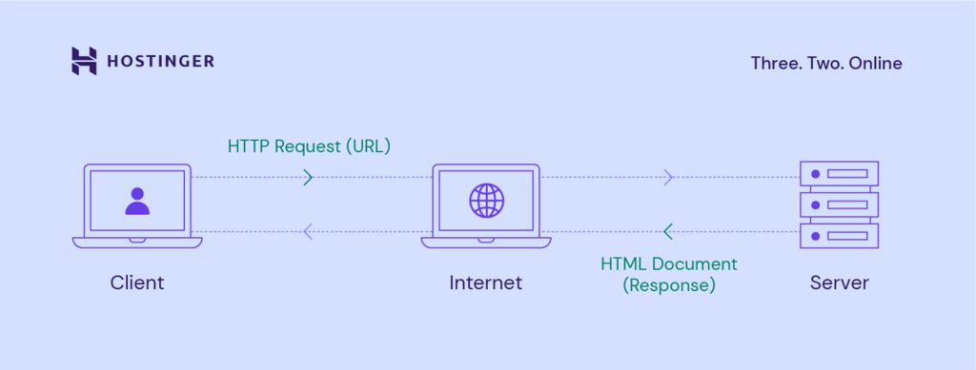
What is web server ?
A web server is software and hardware that uses HTTP (Hypertext Transfer Protocol) and other protocols to respond to client requests made over the World Wide Web.
The main job of a web server is to display website content through storing, processing and delivering webpages to users. It is based on client server model.

Slide 5
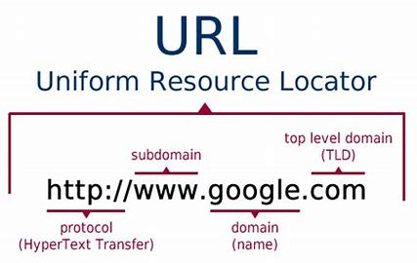
What is URL ?
A URL (Uniform Resource Locator) is a unique identifier used to locate a resource on the Internet.

Slide 6
What is domain name ?
A domain name is a unique address used to access a website.

Slide 7
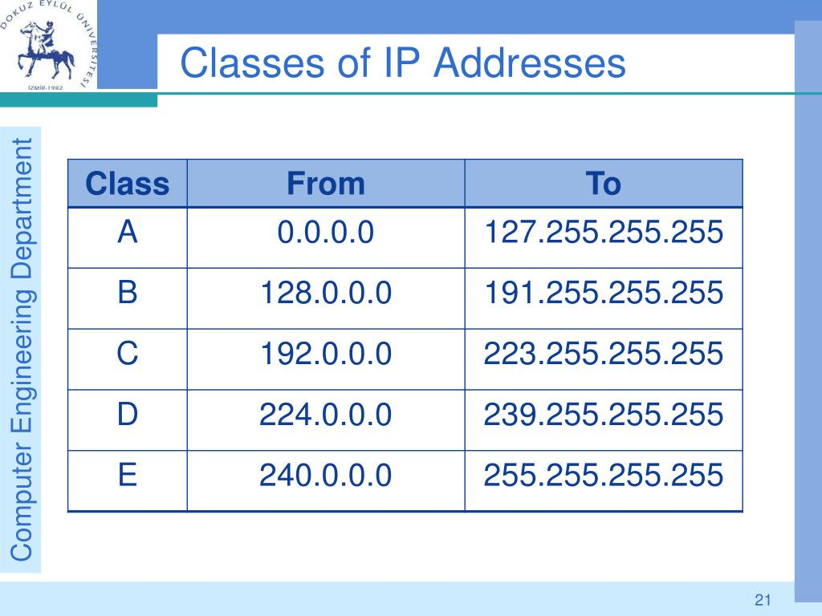
What is IP address ?
The Internet Protocol Address (or IP Address) is a unique address that computing devices such as personal computers, tablets, and smartphones use to identify itself and communicate with other devices in the IP network.
An IP address uniquely identifies a device on a network.

Slide 8
IPv6
An Internet Protocol Version 6 address (IPv6 address) is a numeric label that is used to identify and locate a network interface of a computer or a network node participating in a computer network using IPv6.
IPv6 address is represented as eight groups of four hexadecimal digits, each group representing 16 bits The groups are separated by colons (:). An example of an IPv6 address is:
2001:0db8:85a3:0000:0000:8a2e:0370:7334

Slide 9
Thanks

